Slide 1


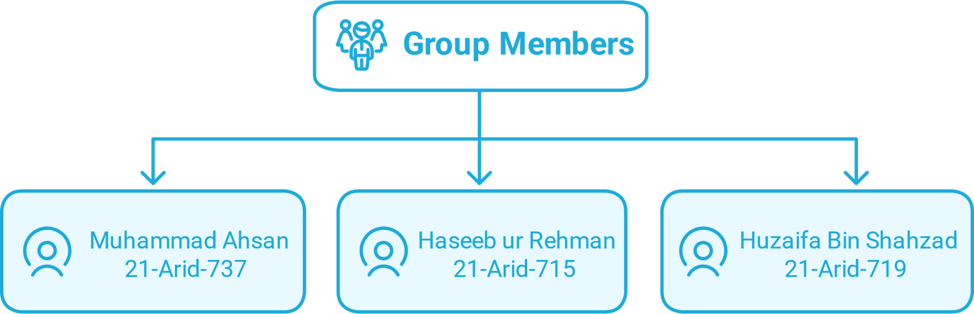

Constituency Connect
UNIVERSITY INSTITUTE OF INFORMATION TECHNOLOGY

Slide 2
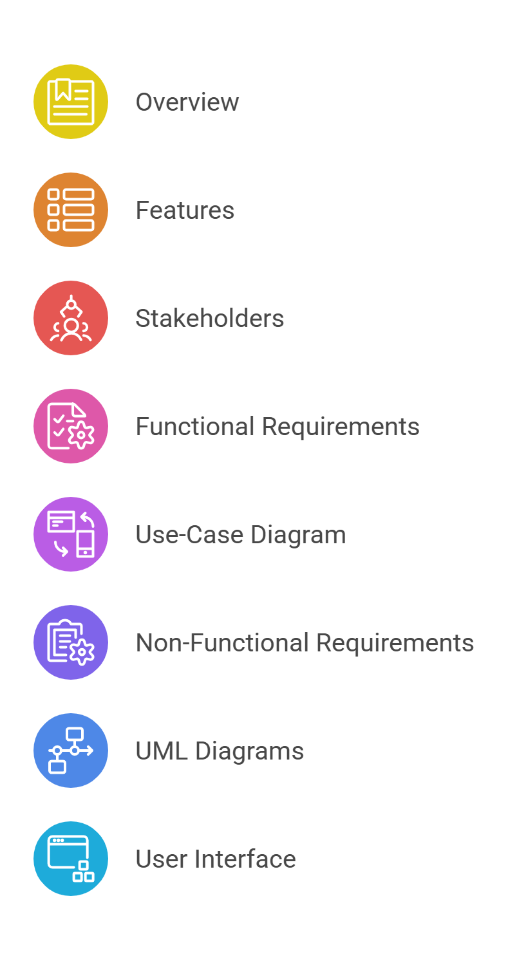
Table of Contents

Slide 3
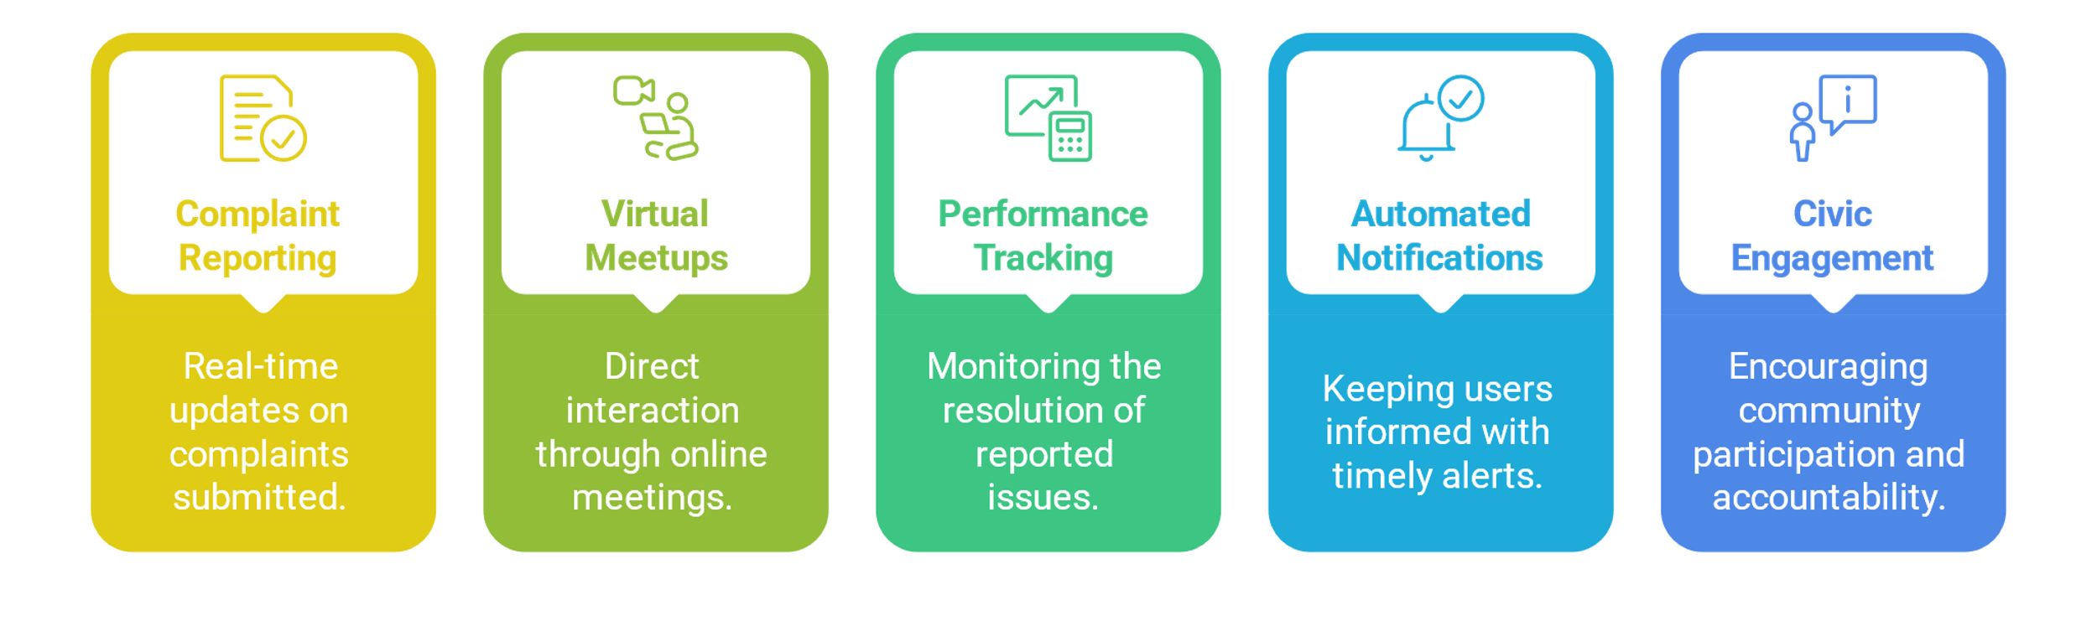
Brief Overview
Bridges communication gaps between constituents and representatives.
Empower citizens to voice concerns effectively and transparently.

Slide 4
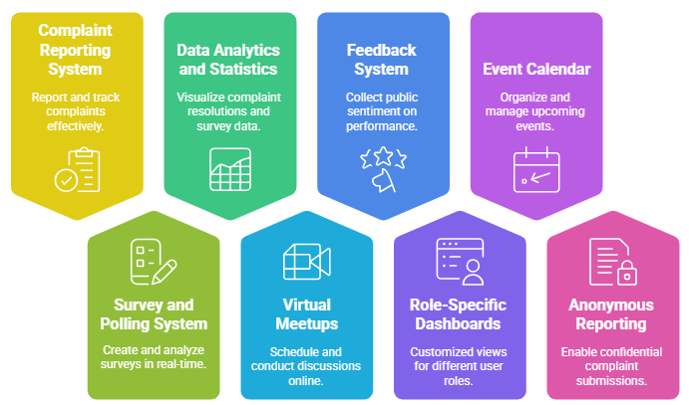
Project Features:

Slide 5
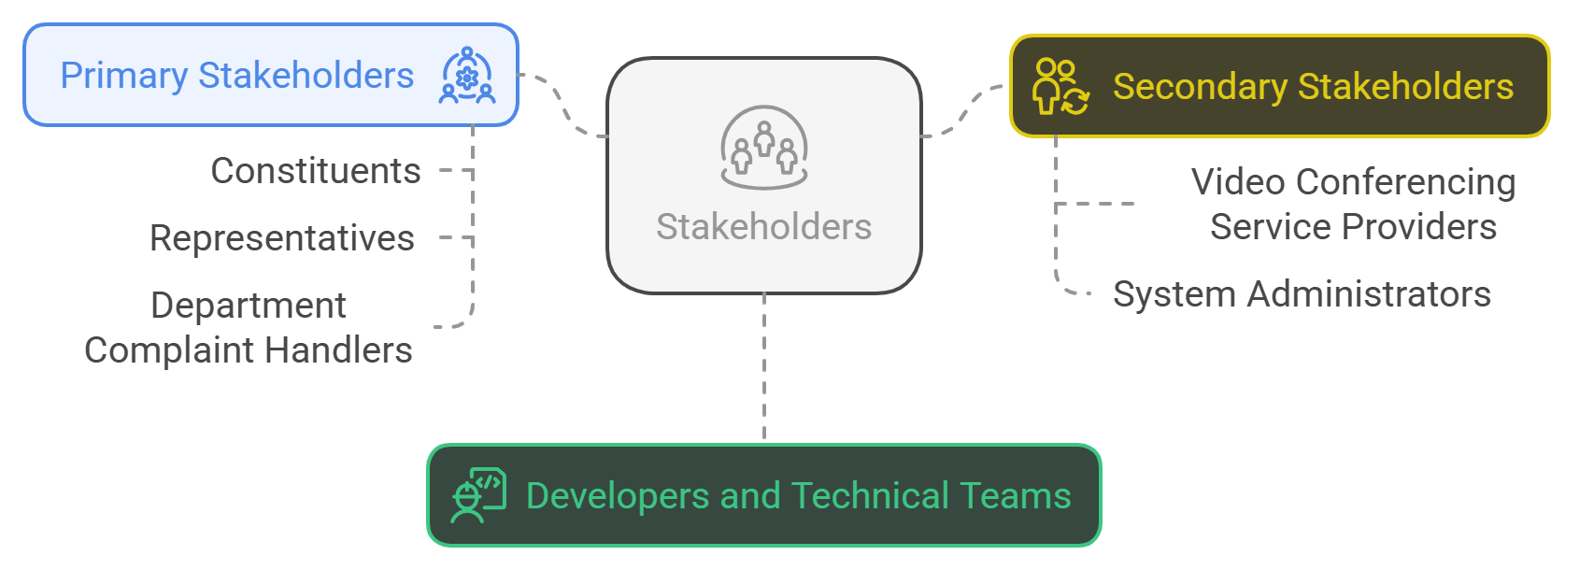
Stakeholders

Slide 6
Functional Requirements
Users (Constituents and Representatives):
The system shall allow users (constituents and representatives) to register on the platform.
Users shall be able to log in to their accounts using valid credentials.
Constituents:
Constituents shall be able to report a complaint to their respective representatives through the system.
Constituents shall be able to track the status of their complaints.
Constituents shall have access to a history of their submitted complaints.

Slide 7
Functional Requirements
Constituents shall be able to track the status of their complaints.
Constituents shall have access to a history of their submitted complaints.
Constituents shall be able to view their representative's performance statistics, including (Total complaints received, number of complaints resolved, pending complaints, and Total meetups conducted etc).
Constituents shall be able to participate in surveys and polls organized by their representatives.
Constituents shall be able to attend virtual meetups arranged by their representatives.

Slide 8
Functional Requirements
Constituents shall be able to provide feedback on complaint resolutions and representative performance.
Representatives:
Representatives should only register with their official email address (e.g., johndoe@na.gov.pk).
Representatives shall be able to create and distribute custom surveys to gather insights from constituents.
Representatives shall have the ability to schedule and host virtual meetings with constituents.

Slide 9
Functional Requirements
Representatives shall be able to update the status of complaints to reflect progress or resolution.
Representatives shall be able to forward complaints to the relevant departments for action.
Representatives shall be able to post-event calendars displaying upcoming community events and public meetings.
Representatives shall be able to run awareness campaigns.

Slide 10
Functional Requirements
Department Complaint Handlers:
The Department Complaint Handler shall be able to update the status of complaints to reflect progress or resolution.
Miscellaneous:
Notify constituents about complaint updates and upcoming meetings.
Display survey results using charts and graphs.
Highlight sensitive complaints for urgent action.

Slide 11
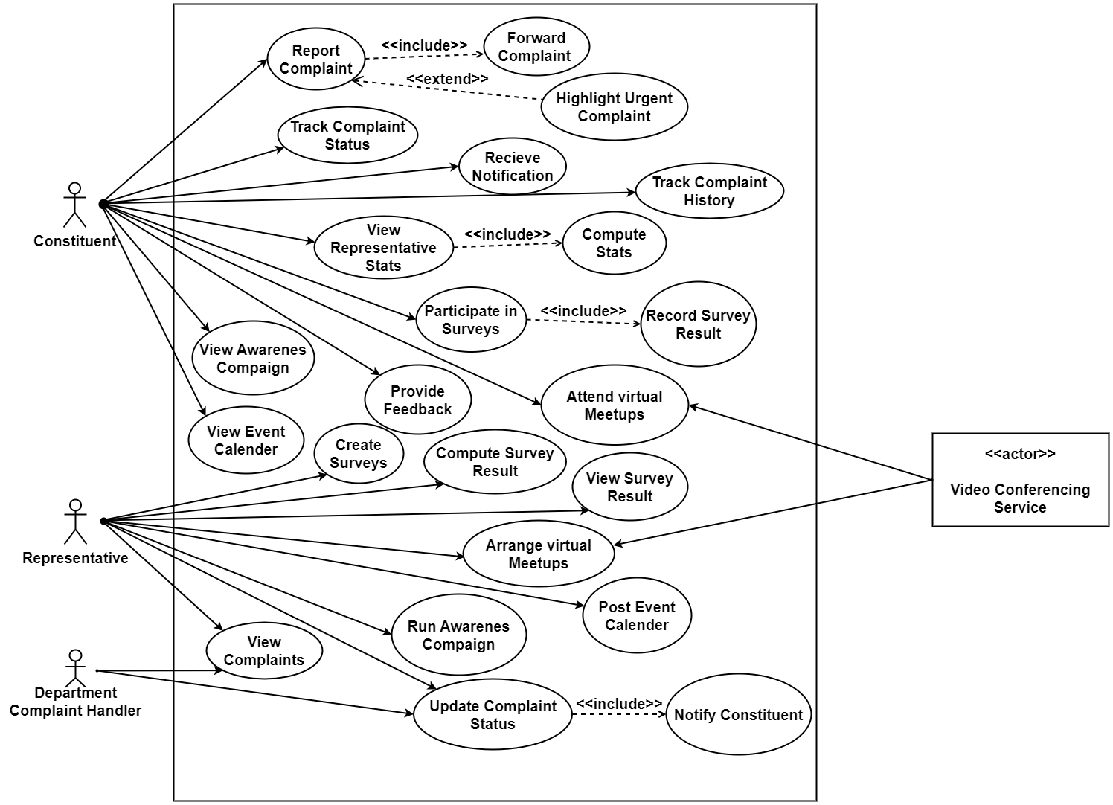
Use-Case Diagram

Slide 12
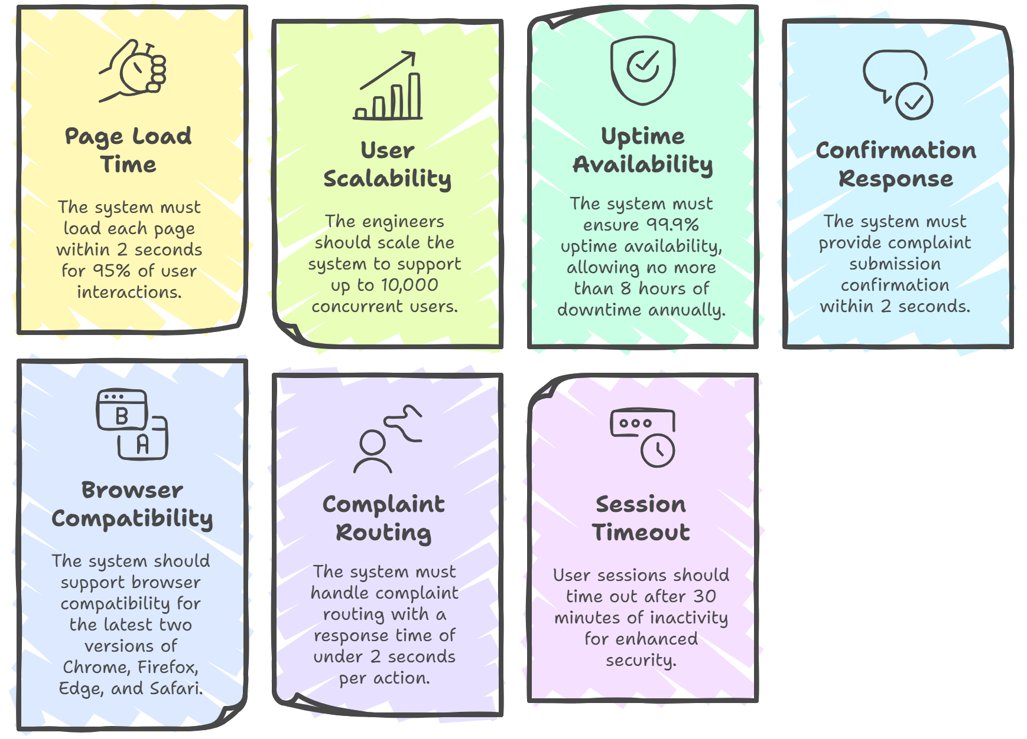
6.Non-Functional Requirements

Slide 13
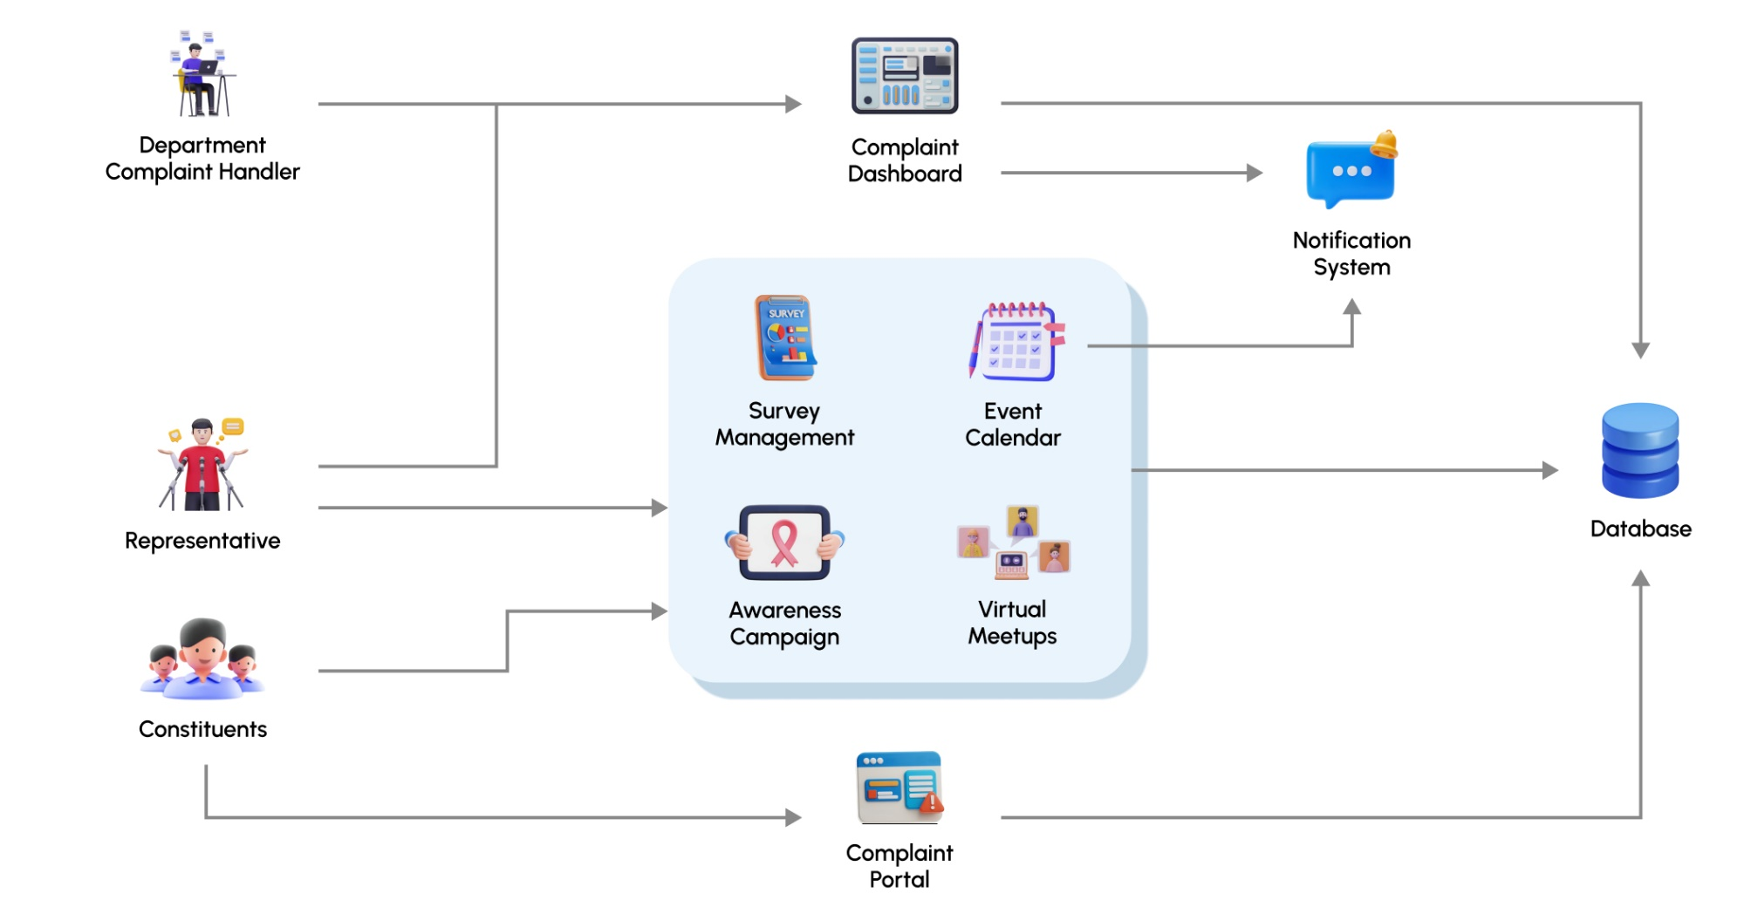
Block Diagram

